Slide 1

Reprogramming in DA RADAR
Prepared by:
Phan Thanh Hoang
Reviewed and validated by:
Usha Manohar
Vignesh Prakash
Internal | hop2hc (EVH/EMB3) | 30/05/2014 | © Robert Bosch Engineering and Business Solutions Limited 2014. All rights reserved, also regarding any disposal, exploitation, reproduction, editing, distribution, as well as in the event of applications for industrial property rights.

Slide 2
Agenda
Reprogramming in DA RADAR
MRR1 & LRR4 Flash layout
Features of Boot loader
Programming sequence
Reprogramming by Diagnostic services
Internal | hop2hc (EVH/EMB3) | 30/05/2014 | © Robert Bosch Engineering and Business Solutions Limited 2014. All rights reserved, also regarding any disposal, exploitation, reproduction, editing, distribution, as well as in the event of applications for industrial property rights.

Slide 3
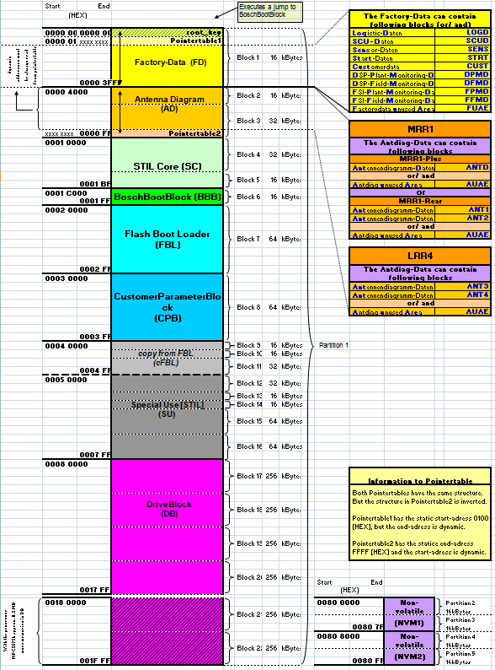
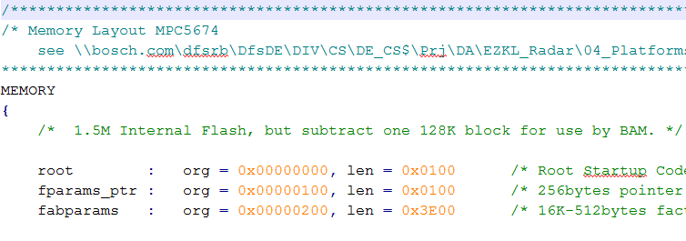
MRR1 & LRR4 Flash layout
Reprogramming in DA RADAR
There are multiple blocks in ECU flash for different purposes.
Memory layout is design not only to cover the flash, but also NVM implementation (EEPROM)
Number of blocks and ranges for each one could be configured statically in linker command file (.lcf)
Internal | hop2hc (EVH/EMB3) | 30/05/2014 | © Robert Bosch Engineering and Business Solutions Limited 2014. All rights reserved, also regarding any disposal, exploitation, reproduction, editing, distribution, as well as in the event of applications for industrial property rights.
Notes:
In MRR1/LRR4, NVM is implemented as AUTOSAR compliant.
Actually, the PPC doesn’t have EEPROM, so NVM is mostly based on FEE (Flash EEPROM emulation), and abstracted by the MemIf layer.

Slide 4
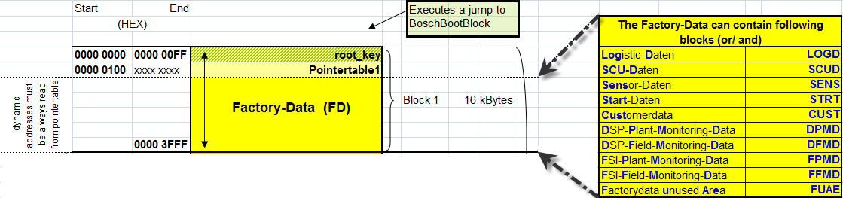
MRR1 & LRR4 Flash layout
Reprogramming in DA RADAR
The first block is the root key, it contains the instruction to jump to BoschBootBlock
Next is the pointer table 1 – which points to factory parameters
Factory-data contains a lot of information about customer.
This section of memory only be modified in plant.
Application may read data from here for some particular purposes, e.g. ECU spare part number, component ID, hardware number...
Internal | hop2hc (EVH/EMB3) | 30/05/2014 | © Robert Bosch Engineering and Business Solutions Limited 2014. All rights reserved, also regarding any disposal, exploitation, reproduction, editing, distribution, as well as in the event of applications for industrial property rights.

Slide 5
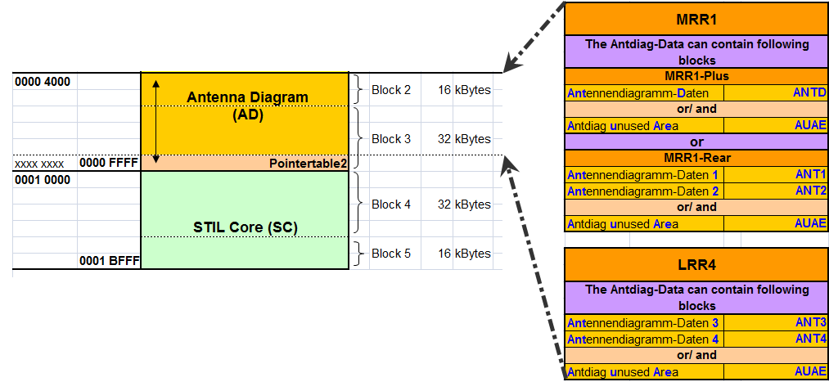
MRR1 & LRR4 Flash layout
Reprogramming in DA RADAR
Next is Antenna Diagram section, it contains Antenna data only
Both pointer tables (1 and 2) have the same structure, but inverted.
Pointer table 1 is for Factory data mapping, start address is fixed, end address is dynamic
Pointer table 2 is for Antenna data mapping, start address is dynamic, end address is fixed
Internal | hop2hc (EVH/EMB3) | 30/05/2014 | © Robert Bosch Engineering and Business Solutions Limited 2014. All rights reserved, also regarding any disposal, exploitation, reproduction, editing, distribution, as well as in the event of applications for industrial property rights.

Slide 6
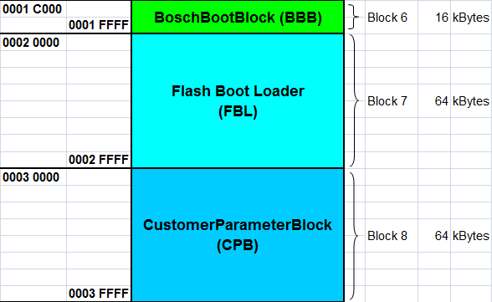
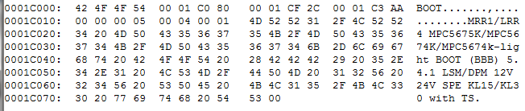
MRR1 & LRR4 Flash layout
Reprogramming in DA RADAR
Next is BoschBootBlock, which contains the instruction to be executed before entering customer specific bootblock (FBL)
Internal | hop2hc (EVH/EMB3) | 30/05/2014 | © Robert Bosch Engineering and Business Solutions Limited 2014. All rights reserved, also regarding any disposal, exploitation, reproduction, editing, distribution, as well as in the event of applications for industrial property rights.

Slide 7
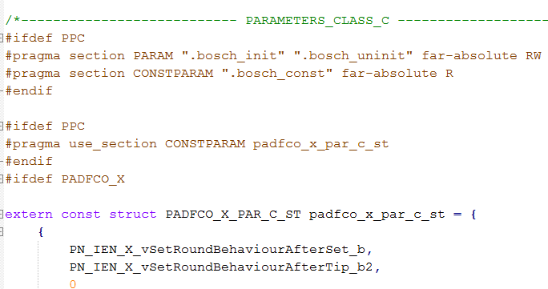
MRR1 & LRR4 Flash layout
Reprogramming in DA RADAR
The CPB contains customer specific data, e.g. Checksum for HEX patch, software version check consistency, BOSCH constant parameter (class C and D)
Internal | hop2hc (EVH/EMB3) | 30/05/2014 | © Robert Bosch Engineering and Business Solutions Limited 2014. All rights reserved, also regarding any disposal, exploitation, reproduction, editing, distribution, as well as in the event of applications for industrial property rights.

Slide 8
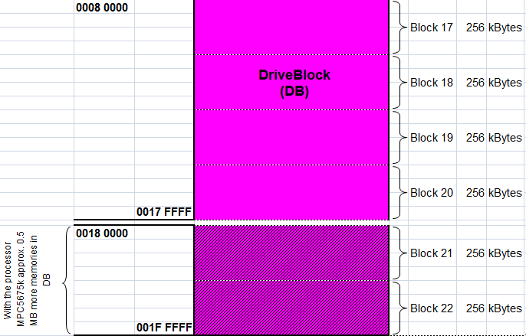
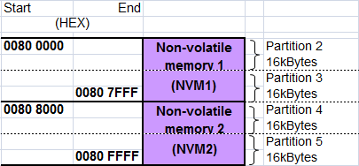
MRR1 & LRR4 Flash layout
Reprogramming in DA RADAR
DriveBlock is the main section for application’s instructions. It maybe divided into several smaller sections for different purposes
There are 2 pages of NVM – which support for inter-software component communication
The NVM is implemented above memory interface, which mostly from Flash EEPROM emulation.
Internal | hop2hc (EVH/EMB3) | 30/05/2014 | © Robert Bosch Engineering and Business Solutions Limited 2014. All rights reserved, also regarding any disposal, exploitation, reproduction, editing, distribution, as well as in the event of applications for industrial property rights.

Slide 9

Introduction
Flash Bootloader
What is Flash Bootloader ??
It is a Program to program (Flash) the Application software and other operating data.
Why Bootloader ??
When a ECU is first powered on, it may not have any Application Software in Flash or RAM.
ECU must initially execute a small program stored in Flash along with the bare minimum of data needed to access all the devices from which the Application Software and data are loaded into Flash/RAM.
To allow erasing and programming new applications on ECU in case of application updates, configuration changes.
Internal | CC-DA/EST2 - RBEI/EAC1 | 30/05/2014 | © Robert Bosch Engineering and Business Solutions Limited 2014. All rights reserved, also regarding any disposal, exploitation, reproduction, editing, distribution, as well as in the event of applications for industrial property rights.

Slide 10
Features of Flash Bootloader
Flash Bootloader
Resides in Flash memory and always the first application to run after reset.
Flash bootloaders are based on communication protocol such as CAN, Flexray etc.
Flash Bootloaders use a Diagnostic protocol to communicate and download to an ECU
An ECU has at least two partitions (Application and Bootloader)
Bootloader and application contains separate program code for Communication functions (COM stack)
Bootloader guarantees the programming of ECU even after the interruptions such as voltage, communication interruptions.
Internal | CC-DA/EST2 - RBEI/EAC1 | 30/05/2014 | © Robert Bosch Engineering and Business Solutions Limited 2014. All rights reserved, also regarding any disposal, exploitation, reproduction, editing, distribution, as well as in the event of applications for industrial property rights.

Slide 11
Bootloader Architecture
Flash Bootloader
Bootloader
Diagnostic Services
Timing Module
TP
EEPROM Data Handling
Communication Driver (CAN/Flexray)
EEPROM Driver
Microcontroller
Internal | CC-DA/EST2 - RBEI/EAC1 | 30/05/2014 | © Robert Bosch Engineering and Business Solutions Limited 2014. All rights reserved, also regarding any disposal, exploitation, reproduction, editing, distribution, as well as in the event of applications for industrial property rights.

Slide 12
Diagnostic functionality in Flash Bootloader (Based on UDS)
Flash Bootloader
DiagnosticSessionControl ($10)
ECU Reset ($11)
ReadDataByIdentifier ($22)
Security Access ($27)
Communication Control ($28)
WriteDataByIdentifier ($2E)
Routine Control ($31)
Request Download ($34)
Transfer Data ($36)
Request Transfer Exit ($37)
Tester Present ($3E)
ControlDTCSettings ($85)
Internal | CC-DA/EST2 - RBEI/EAC1 | 30/05/2014 | © Robert Bosch Engineering and Business Solutions Limited 2014. All rights reserved, also regarding any disposal, exploitation, reproduction, editing, distribution, as well as in the event of applications for industrial property rights.

Slide 13
Flash Bootloader
Session Transition
Internal | CC-DA/EST2 - RBEI/EAC1 | 30/05/2014 | © Robert Bosch Engineering and Business Solutions Limited 2014. All rights reserved, also regarding any disposal, exploitation, reproduction, editing, distribution, as well as in the event of applications for industrial property rights.

Slide 14
Programming Sequence
Flash Bootloader
Pre-programming
Programming Execution
Post-programming
Internal | CC-DA/EST2 - RBEI/EAC1 | 30/05/2014 | © Robert Bosch Engineering and Business Solutions Limited 2014. All rights reserved, also regarding any disposal, exploitation, reproduction, editing, distribution, as well as in the event of applications for industrial property rights.

Slide 15
Pre-programming
Flash Bootloader
After Startup, ECU will be in Default Session of Application or Bootloader
Preprograming sequence is carried out before
Transferring to Bootloader (if in application default session) OR
Initiating programming request (if in Bootloader default session)
SEQUENCE
Switch to Extended Diagnostic session
Check Programming Preconditions (Routine Control).
Engine speed, Vehicle Speed, Temperature etc.
DTC setting off
DTC logging is disabled
Block Inter-ECU communication
Internal | CC-DA/EST2 - RBEI/EAC1 | 30/05/2014 | © Robert Bosch Engineering and Business Solutions Limited 2014. All rights reserved, also regarding any disposal, exploitation, reproduction, editing, distribution, as well as in the event of applications for industrial property rights.

Slide 16
Flash Bootloader
Flash Bootloader
Flash Bootloader
Flash Bootloader
Programming sequence
NVM
BOSCH BOOT BLOCK
FACTORY DATA
CUSTOMER BOOT BLOCK
Contains the Diagnostic services for flashing
DRIVE BLOCK
JUMP TO PROGRAMMING
SESSION
Internal | CC-DA/EST2 - RBEI/EAC1 | 30/05/2014 | © Robert Bosch Engineering and Business Solutions Limited 2014. All rights reserved, also regarding any disposal, exploitation, reproduction, editing, distribution, as well as in the event of applications for industrial property rights.

Slide 17
Flash Bootloader
RAM AREA
NVM
2) DOWNLOAD FLASH ROUTINES TO RAM AREA
BOSCH BOOT BLOCK
FLASH TOOL
FACTORY DATA
CUSTOMER BOOT BLOCK
DRIVE BLOCK
1) SEND DIAGNOSTIC REQUEST FOR DOWNLOADING FLASH ROUTINES TO RAM
Internal | CC-DA/EST2 - RBEI/EAC1 | 30/05/2014 | © Robert Bosch Engineering and Business Solutions Limited 2014. All rights reserved, also regarding any disposal, exploitation, reproduction, editing, distribution, as well as in the event of applications for industrial property rights.

Slide 18
Flash Bootloader
Flash Bootloader
Flash Bootloader
Flash Bootloader
Flash Bootloader
RAM AREA
NVM
4) CBB INVOKES THE RAM AREA AS PER THE REQUEST SENT
BOSCH BOOT BLOCK
FLASH TOOL
FACTORY DATA
CUSTOMER BOOT BLOCK
DRIVE BLOCK
3) SEND DIAGNOSTIC REQUEST FOR DOWNLOADING DRIVE BLOCK TO RAM
5) FLASH ROUTINES ARE UTILISED FOR ERASING AND FLASHING THE DRIVE BLOCK
Internal | CC-DA/EST2 - RBEI/EAC1 | 30/05/2014 | © Robert Bosch Engineering and Business Solutions Limited 2014. All rights reserved, also regarding any disposal, exploitation, reproduction, editing, distribution, as well as in the event of applications for industrial property rights.

Slide 19
Programming Execution
Flash Bootloader
Switch to Programming Session
Request for Security Access (Seed and Key algorithm)
Write Fingerprint (Tester serial Number, Programming Date)
Erase the required Memory
Request for the Download of software
Transfer the Software Data
Request for exiting from Data transfer
Check Programming Dependencies
Reset the ECU
Note: If the flash routines are not part of the Bootloader, these have to be loaded into RAM using the above sequence (Except ECU Reset) before flashing to Flash sections.
Internal | CC-DA/EST2 - RBEI/EAC1 | 30/05/2014 | © Robert Bosch Engineering and Business Solutions Limited 2014. All rights reserved, also regarding any disposal, exploitation, reproduction, editing, distribution, as well as in the event of applications for industrial property rights.

Slide 20
Post-programming
Flash Bootloader
Enable Inter- ECU communication
Enable DTC logging
Switch to Default Session
Internal | CC-DA/EST2 - RBEI/EAC1 | 30/05/2014 | © Robert Bosch Engineering and Business Solutions Limited 2014. All rights reserved, also regarding any disposal, exploitation, reproduction, editing, distribution, as well as in the event of applications for industrial property rights.

Slide 21
Reprogramming by Diagnostic services
Reprogramming in DA RADAR
Application and FBL usually share information through NVM interface.
Once the reprogramming request is accepted, the application shall set a flag to this interface, perform all necessary actions for pre-programming sequence then reset ECU to pass the control to FBL
Internal | hop2hc (EVH/EMB3) | 30/05/2014 | © Robert Bosch Engineering and Business Solutions Limited 2014. All rights reserved, also regarding any disposal, exploitation, reproduction, editing, distribution, as well as in the event of applications for industrial property rights.
Notes:
The reprogramming function is the one to enable the software renewal of the electronically controlled controller(following ECU) in vehicle(through connector adapted for car diagnosis), or single state, using a particular communication function

Slide 22
Reprogramming by Diagnostic services
Reprogramming in DA RADAR
Reprogramming always has some common requirements: executes in programming session, passes security access.
The diagnostic system shall also take care of some other special precondition check, and follow the pre-programming sequence: disable DTC logging, block ECU communication
After all, it shall set the reprogramming flag into NVM then perform a software reset
Internal | hop2hc (EVH/EMB3) | 30/05/2014 | © Robert Bosch Engineering and Business Solutions Limited 2014. All rights reserved, also regarding any disposal, exploitation, reproduction, editing, distribution, as well as in the event of applications for industrial property rights.

Slide 23
Reprogramming by Diagnostic services
Reprogramming in DA RADAR
There are many diagnostic services involve into the reprogramming features
FBL interaction – set or reset the shared reprogramming flag in NVM – is always the key of reprogramming
It will be done by a particular service, that service is different from customer by customer.
Suzuki: RequestDownload ($34)
Nissan: StartDiagnosticSession ($10 $85)
MMC:
FIAT:
HKMC:
...
Internal | hop2hc (EVH/EMB3) | 30/05/2014 | © Robert Bosch Engineering and Business Solutions Limited 2014. All rights reserved, also regarding any disposal, exploitation, reproduction, editing, distribution, as well as in the event of applications for industrial property rights.

Slide 24
References
Reprogramming in DA RADAR
FLASH_TOOL_Diatester.ppt – Vignesh Prakash
Adressbereiche_MRR1_LRR4_Release_5_higher.xls – Jochen Klier
JP customer requirements
Internal | hop2hc (EVH/EMB3) | 30/05/2014 | © Robert Bosch Engineering and Business Solutions Limited 2014. All rights reserved, also regarding any disposal, exploitation, reproduction, editing, distribution, as well as in the event of applications for industrial property rights.

